Slide 1
Large Language Model Agents (LLM) Education Course: A Comprehensive MOOC for Students, Researchers, and Professionals
Mastering AI concepts through an inclusive online course
Notes:
AI-generated content may be incorrect. --- Welcome to the comprehensive MOOC on Large Language Model Agents designed for students, researchers, and professionals aiming to master the fundamentals and advanced concepts of LLMs in modern AI applications.

Slide 2
Course Agenda Overview
Title Slide: Welcome to LLM Education Course
Course Overview: Your Path to LLM Mastery
Module 1 – Introduction to Large Language Models
Module 1 – History and Evolution of LLMs
Module 1 – Real-World Applications of LLMs
Module 2 – LLM Architecture: Neural Networks & Transformers
Module 2 – Processing Inputs and Outputs
Module 2 – Training and Fine-Tuning LLMs
Module 3 – Natural Language Processing Basics
Module 3 – Common NLP Tasks with LLMs
Module 4 – LLM Applications Across Industries
Module 5 – Ethics in LLMs: Challenges and Responsibilities
Module 6 – Advanced Topics: Multimodal & Dialogue Systems
Notes:
This course covers the introduction, history, architecture, natural language processing basics, applications across industries, ethical considerations, and advanced topics related to Large Language Models. Each module provides visual aids to enhance understanding.

Slide 3
Title Slide: Welcome to LLM Education Course
Notes:
This slide introduces the course name along with a captivating AI-themed image to set the tone for an engaging learning experience focused on LLM technologies.

Slide 4

Course Name and Subtitle
Clear Course Identity
Display the official course title prominently to establish clear identity and recognition for participants.
Subtitle for Objectives
Include a subtitle that summarizes course objectives to guide participants' expectations and focus.
Notes:
--- Present the official course title and subtitle clearly to establish the course identity and objectives for participants. Image source: Microsoft 365 content library

Slide 5

Modern, Engaging AI-Themed Image
Innovative AI Visualization
Showcase a futuristic digital brain illustrating neural networks and artificial intelligence concepts vividly.
Modern AI Technology
Represent the cutting-edge and modern aspects of large language model technology through engaging visuals.
Notes:
--- Display a visually appealing AI-related image that reflects the innovative and modern nature of LLM technology to engage learners right from the start. Image source: Microsoft 365 content library

Slide 6
Course Overview: Your Path to LLM Mastery
Notes:
This section outlines the course goals, structure, and learning outcomes, providing students with a roadmap to mastering LLM concepts and applications.

Slide 7

Brief MOOC Description and Objectives
Course Purpose Overview
The MOOC aims to provide comprehensive knowledge and practical skills on the subject matter.
Key Learning Objectives
Students will achieve specific competencies and understanding outlined at the start of the course.
Notes:
--- Summarize the course’s purpose and key learning objectives to help students understand what they will achieve by completing the MOOC. Image source: Microsoft 365 content library

Slide 8

Visual: Online Learning Platform Image
Digital Learning Environment
The platform offers an interactive digital space for students to engage with educational content and peers.
Student Engagement
Visuals encourage active participation and collaboration among students within the online platform.
Notes:
--- Showcase an image representing the online learning environment to familiarize students with the platform and encourage active participation. Image source: Microsoft 365 content library

Slide 9
Module 1 – Introduction to Large Language Models
Notes:
Introduce the fundamental concepts of LLMs including definitions and their capabilities in the AI landscape.

Slide 10

What LLMs Are and What They Can Do
Core Features of LLMs
LLMs are trained on vast text data to understand language patterns and context effectively.
Human-like Text Generation
They can generate coherent, context-aware, and natural-sounding human-like text responses.
Notes:
--- Explain the core features and functionalities of Large Language Models, emphasizing their ability to understand and generate human-like text. Image source: Microsoft 365 content library

Slide 11
Visual: AI Brain or Neural Network
AI Brain Structure
The AI brain visualizes the complex neural architecture powering intelligent systems like LLMs.
Neural Network Connectivity
Neural networks consist of interconnected nodes that simulate human brain function for learning.
LLM Neural Architecture
Large language models rely on deep neural architectures to process and generate language data.
Notes:
--- Use an illustrative image of an AI brain or neural network to visually represent the neural architecture behind LLMs. Image source: Microsoft 365 content library

Slide 12
Module 1 – History and Evolution of LLMs
Notes:
Discuss the historical development of LLMs from early models to the latest advancements like GPT-4.

Slide 13

Overview From Early Models to GPT-4
Early Language Models
Initial language models introduced basic natural language processing but had limited context understanding.
Transformer Architecture
The introduction of transformer architecture enabled better context capturing and parallel processing.
GPT Series Evolution
GPT models progressively improved language understanding and generation, culminating in GPT-4's advanced capabilities.
Notes:
--- Provide a timeline of key milestones in LLM evolution, highlighting important breakthroughs and improvements in model capabilities. Image source: Microsoft 365 content library

Slide 14

Visual: Timeline of LLM Milestones
Early Foundations
Initial research and foundational models laid the groundwork for modern large language models.
Breakthrough Models
Introduction of major LLM architectures significantly improved natural language understanding and generation.
Recent Innovations
Latest advancements enhanced model scale, capabilities, and applications across various domains.
Notes:
--- Present a graphical timeline showcasing major developments in the history of LLMs to help students visualize progress over time. Image source: Microsoft 365 content library

Slide 15
Module 1 – Real-World Applications of LLMs
Notes:
Explore how LLMs have transformed various industries by enabling new solutions in education, business, and healthcare.

Slide 16

Industries Transformed: Education, Business, Healthcare
Education Enhancement
LLMs personalize learning by adapting content to individual student needs and improving engagement.
Business Efficiency
LLMs automate workflows, enhance decision-making, and optimize customer interactions for better business outcomes.
Healthcare Solutions
LLMs assist in diagnosing complex cases, managing patient data, and supporting medical research innovations.
Notes:
--- Highlight specific use cases where LLMs improve efficiency, personalize experiences, and solve complex problems across sectors. Image source: Microsoft 365 content library

Slide 17

Visual: Collage Showing Sectors
Healthcare Industry
LLM technologies enhance diagnostic accuracy and patient care through data-driven insights.
Financial Services
AI-powered language models improve fraud detection and customer service in finance sectors.
Education Sector
LLMs provide personalized learning experiences and educational content generation.
Technology and Innovation
LLMs drive advancements in software development and natural language understanding.
Notes:
--- Display a collage image representing different industries impacted by LLM technologies to reinforce the diversity of applications. Image source: Microsoft 365 content library

Slide 18
Module 2 – LLM Architecture: Neural Networks & Transformers
Notes:
Delve into the technical architecture of LLMs focusing on neural networks and transformer models that power their performance.

Slide 19

Key Components: Layers, Attention, Transformers
Attention Mechanisms
Attention mechanisms allow models to focus on important parts of input data, improving context understanding.
Transformer Layers
Transformer layers use self-attention and feed-forward networks to process data efficiently in LLMs.
Notes:
--- Explain the essential components such as attention mechanisms and transformer layers that enable efficient data processing in LLMs. Image source: Microsoft 365 content library

Slide 20

Visual: Schematic Diagram of Model
Transformer Architecture Overview
The transformer model architecture consists of stacked encoder and decoder layers designed for sequence processing.
Attention Mechanism
Self-attention mechanisms allow the model to weigh the importance of different input elements dynamically.
Positional Encoding
Positional encoding provides sequence order information to the model in the absence of recurrent structure.
Notes:
--- Provide a schematic diagram of a transformer model to visually break down the architecture and facilitate comprehension. Image source: Microsoft 365 content library

Slide 21
Module 2 – Processing Inputs and Outputs
Notes:
Describe how LLMs process user queries and generate coherent responses through complex computational steps.

Slide 22
How LLMs Handle Queries and Generate Responses
Input Tokenization
Queries are broken down into tokens, converting text into manageable data for processing by the model.
Model Inference
The model processes tokens through multiple layers to predict meaningful responses based on learned patterns.
Output Generation
The system assembles token predictions into coherent sentences to generate human-like answers.
Notes:
--- Detail the flow from input tokenization, model inference, to output generation to clarify the inner workings of LLM interactions. Image source: Microsoft 365 content library

Slide 23
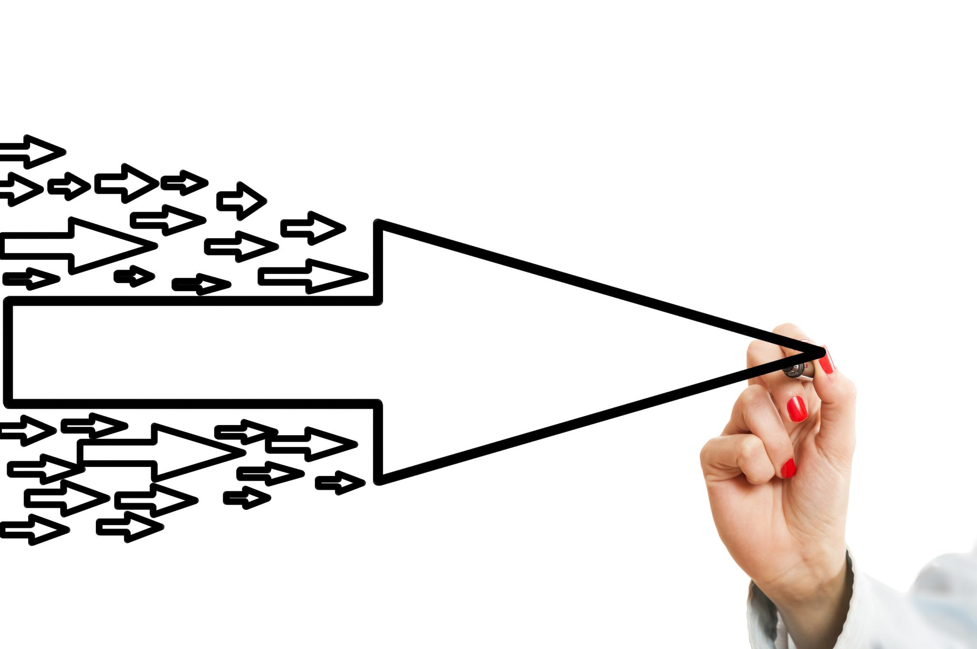
Visual: Input/Output Flowchart
Input Reception
The model receives input text data to begin processing. This initial step triggers the flowchart sequence.
Processing Mechanics
The flowchart shows how the model analyzes and processes input through various internal steps.
Output Generation
Final output is produced based on input data processing, completing the flowchart sequence.
Notes:
--- Use a flowchart to illustrate the step-by-step input and output processing within an LLM, enhancing learner understanding. Image source: Microsoft 365 content library

Slide 24
Module 2 – Training and Fine-Tuning LLMs
Notes:
Cover the methodologies behind pre-training, transfer learning, and fine-tuning that customize LLMs for specific tasks.

Slide 25

Overview of Pre-Training, Transfer Learning, Fine-Tuning
Pre-Training Phase
Pre-training involves training a language model on vast amounts of general data to learn broad language patterns and knowledge.
Transfer Learning Phase
Transfer learning adapts the pre-trained model to new domains or tasks by reusing learned representations.
Fine-Tuning Phase
Fine-tuning trains the model on task-specific data to improve performance on specialized applications.
Notes:
--- Explain each training phase and how they contribute to building versatile and task-specific LLM capabilities. Image source: Microsoft 365 content library

Slide 26

Visual: Coding Interface or Training Process
Coding Environment Overview
A coding interface provides developers with tools to write, test, and debug code efficiently during LLM development.
Training Process Visualization
The training process involves running large datasets through AI models to improve accuracy and performance.
Notes:
--- Show a visual of a coding environment or training process to contextualize the technical effort behind LLM development. Image source: Microsoft 365 content library

Slide 27
Module 3 – Natural Language Processing Basics
Notes:
Introduce foundational NLP concepts such as tokenization, stemming, and lemmatization critical for text processing in LLMs.

Slide 28
Tokenization, Stemming, Lemmatization Principles
Tokenization
Tokenization breaks text into smaller units called tokens, facilitating easier text analysis.
Stemming
Stemming reduces words to their root form by removing suffixes, simplifying text data.
Lemmatization
Lemmatization converts words to their dictionary base form, improving accuracy in text processing.
Notes:
--- Define these core NLP techniques and discuss their roles in preparing text data for analysis and modeling. Image source: Microsoft 365 content library

Slide 29

Visual: Text Analysis Diagram
Text Data Input
Text data is first collected from various sources for analysis and processing.
Text Preprocessing
Preprocessing involves cleaning and preparing text by tokenization, normalization, and removal of stopwords.
Feature Extraction
Key features such as keywords, entities, and sentiments are extracted for further analysis.
Data Analysis
Extracted features are analyzed to derive insights and support natural language understanding.
Notes:
--- Present a diagram showing the breakdown and processing of text data to visually explain NLP concepts. Image source: Microsoft 365 content library

Slide 30
Module 3 – Common NLP Tasks with LLMs
Notes:
Explore typical NLP tasks like text classification, sentiment analysis, and summarization enabled by LLMs.

Slide 31

Classification, Sentiment Analysis, Summarization
Text Classification Purpose
Classification assigns predefined categories to text, enabling organized data analysis and retrieval.
Sentiment Analysis Role
Sentiment analysis detects emotional tone in text, revealing opinions and attitudes effectively.
Summarization Functionality
Summarization condenses text to extract essential information, providing concise insights efficiently.
LLMs Effectiveness
Large language models excel at understanding context and nuances, improving accuracy across text tasks.
Notes:
--- Describe each task’s purpose and how LLMs perform them effectively to extract meaning and insights from text. Image source: Microsoft 365 content library

Slide 32

Visual: Dashboard or Analytics Image
Data Dashboard Overview
A data dashboard visually presents key metrics and analytics in a clear and organized manner.
NLP Results Interpretation
Dashboards help in interpreting natural language processing results through graphical data representation.
Notes:
--- Use an image of a data dashboard or analytics tool to illustrate real-world application and interpretation of NLP results. Image source: Microsoft 365 content library

Slide 33
Module 4 – LLM Applications Across Industries
Notes:
Highlight how LLMs are leveraged in customer service, healthcare, and marketing to innovate and improve services.

Slide 34

Customer Service, Healthcare, Marketing Uses
Chatbot Deployment
LLM-powered chatbots enhance customer service by providing instant, accurate responses and support around the clock.
Medical Data Analysis
Large language models analyze complex medical data to assist in diagnosis and improve treatment plans.
Personalized Marketing
LLMs enable personalized marketing strategies by tailoring content and offers based on user data and preferences.
Notes:
--- Provide examples of chatbot deployment, medical data analysis, and personalized marketing strategies powered by LLMs. Image source: Microsoft 365 content library

Slide 35

Visual: Industry Icons
Technology Industry
Technology sector icons illustrate digital innovation and software development applications of LLMs.
Healthcare Industry
Healthcare icons symbolize medical research, diagnostics, and patient care enhancements using LLMs.
Finance Industry
Finance icons represent banking, investment, and financial analytics powered by LLM technologies.
Manufacturing Industry
Manufacturing icons highlight automation and production process improvements enabled by LLMs.
Notes:
--- Present icons representing key industries to visually reinforce the breadth of LLM applications across sectors. Image source: Microsoft 365 content library

Slide 36
Module 5 – Ethics in LLMs: Challenges and Responsibilities
Notes:
Address critical ethical considerations such as bias, privacy, explainability, and the importance of responsible AI use.

Slide 37

Bias, Privacy, Explainability, Responsible AI
Bias in AI Models
Large language models can exhibit bias reflecting training data, impacting fairness and inclusivity.
Privacy Concerns
Protecting user data privacy is critical when deploying language models to prevent misuse.
Explainability Importance
Transparent AI models help users and stakeholders understand decision-making processes.
Responsible AI Deployment
Implementing ethical guidelines ensures trustworthy and accountable AI system development.
Notes:
--- Discuss potential risks of LLM deployment and strategies to mitigate ethical concerns ensuring trustworthy AI systems. Image source: Microsoft 365 content library

Slide 38

Visual: Balanced Scales
Symbol of Fairness
Balanced scales represent fairness, highlighting the importance of unbiased AI decision-making.
Ethical AI Decision-Making
The image symbolizes ethical balance, emphasizing responsible AI practices and decision processes.
Notes:
--- Use an image of balanced scales to symbolize the need for fairness and ethical balance in AI decision-making. Image source: Microsoft 365 content library

Slide 39
Module 6 – Advanced Topics: Multimodal & Dialogue Systems
Notes:
Explore cutting-edge developments combining text, images, and interactive AI systems to enhance human-computer interaction.

Slide 40

Combining Text, Images, and Interactive AI
Multimodal AI Models
Multimodal models process and combine text, images, and other data for richer AI understanding.
Dialogue Systems
Dialogue systems enable interactive conversations by integrating diverse data types naturally.
Notes:
--- Explain multimodal models and dialogue systems that integrate diverse data types for more dynamic and natural AI experiences. Image source: Microsoft 365 content library

Slide 41

Visual: Futuristic AI Concept
Multimodal AI Integration
The concept illustrates how AI combines visual, auditory, and textual data for smarter interactions.
Interactive AI Capabilities
Interactive AI systems enable dynamic user engagement through real-time responses and adaptations.
Notes:
--- Showcase a futuristic concept image illustrating the integration of multiple modalities and interactive AI capabilities. Image source: Microsoft 365 content library

Slide 42
Conclusion
Comprehensive Course Coverage
The course covers technical foundations, practical applications, and ethical considerations of Large Language Models.
Empowerment Across Disciplines
Learners from diverse backgrounds gain knowledge to utilize Large Language Models effectively.
Encouraging Innovation
The course inspires continuous exploration and innovation in AI and language model development.
Notes:
This course offers a thorough grounding in Large Language Models, covering technical foundations, applications, and ethical considerations to empower learners across disciplines. We encourage continuous exploration and innovation in this exciting field.

